Slide 1
Procedure Oriented Programming
C, Pascal, FORTRAN etc. list of instructions, such as get some input, add these numbers, divide by some number, display that output etc.

Slide 2
Procedure Oriented Programming
Program is divided into functions which have some clearly defined goal in the program. These functions are often called from main function.

Slide 3
Procedure Oriented Approach
Add
Modify
Delete
Main

Slide 4
Procedure Oriented Programming
What about data?
Two kinds of data we deal with:
Local data is hidden inside a function, and is used exclusively by the function and thus is safe from modification by other functions.
Global data can be accessed by any function in the program and thus can be modified by any function.

Slide 5
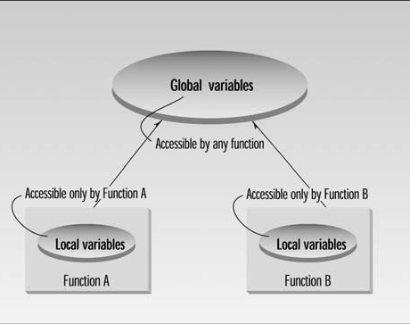
Procedure Oriented Programming
Global and local variables.

Slide 6
Procedure Oriented Programming
In a large program, there are many functions and many global data items. The problem with the procedural approach is that this leads to an even larger number of potential connections between functions and data

Slide 7
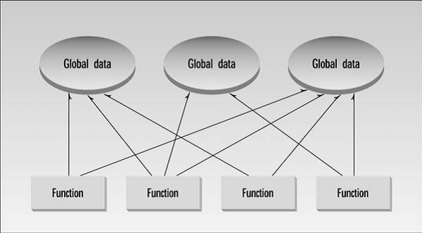
Procedure Oriented Programming

Slide 8
Procedure Oriented Programming
Drawback of global data:
If the data is modified we need to modify all the functions accessing it causing a major maintenance issue. Also when the volume of application is large it becomes difficult to keep a track as to which function has modified which global data.

Slide 9
Procedure Oriented Programming
The second—and more important—problem with the procedural approach is that its arrangement of separate data and functions does a poor job of modelling things in the real world. In the physical world we deal with objects such as people, company, cars etc. Such objects aren’t like data and they aren’t like functions. Complex real-world objects have both attributes and behaviour.

Slide 10
Object Oriented Programming
What is Object Oriented Programming?
Object-oriented programming (OOP) is a programming based on the concept of "objects", which are data structures that contain data, in the form of fields, often known as attributes and code in the form of procedures, often known as methods.

Slide 11
Object Oriented Approach
The fundamental idea behind object-oriented languages is to combine into a single unit both data and the functions that operate on that data. Such a unit is called an object.

Slide 12
Object Oriented Approach
An object’s functions, called member functions, typically provide the only way to access its data. If you want to read a data item in an object, you call a member function in the object. It will access the data and return the value to you. You can’t access the data directly. Thus it provides data security.

Slide 13
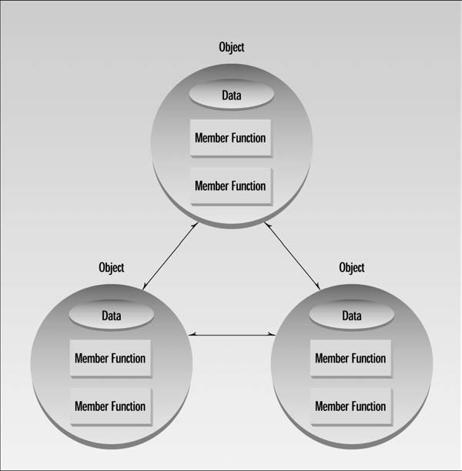
Object Oriented Approach
Arrangement of data and functions operate on that data inside object.

Slide 14
Object Oriented Approach
Object Communication
Calling an object’s member function is also referred to as sending a message to the object.
e.g. Person object invokes “withdrawCash()” member function of ATM object.

Slide 15
Class and Object
A class is a blueprint. You can think of a class as a concept So, let's say you want to use a person in your program. You want to be able to describe the person and have the person do something. A class called 'person' would provide a blueprint for what a person with the attributes such as name, address, gender, age etc. and what a person can do i.e walk,talk,run,eat etc.
Object is an instance of a class. To actually use a person in your program, you need to create an object. You use the person class to create an object of the type 'person.' Now you can describe this person and have it do something. E.g. A person called as Sachin. He must be having some address, age etc. and he can walk, talk, run, eat etc.

Slide 16
Examples of Real world objects
A water-heater is a simple example of an object. It has certain attributes or properties (like color, size, maximum and current temperatures etc.) and there are certain behaviours associated with the water-heater (like switching on the heater, increasing the temperature or heating for a specified time interval, switching off the heater etc.).

Slide 17
Examples of Real world objects
A car is another example of an object. It has a lot of attributes such as fuel capacity, current speed, top speed, number of wheels, type of gearbox etc. There are also a lot of operations which you can perform on this object. For example: you can start ,stop, accelerate the car, apply brakes etc.

Slide 18
Summary of Class and Object
Class | Object/Instance
blueprint | Basic runtime entity
Example 1: Person | Sachin, Rahul, Anil etc.
Example 2: Album | Haunted Melodies By Lata, Sadabahaar Kishore etc.

